Slide 1
Drawing System Sequence Diagrams
System sequence diagram - a diagram that depicts the interaction between an actor and the system for a use case scenario.
  helps identify high-level messages that enter and exit the system
10-<number>
Notes:
Conversion Notes
This is a new topic in the seventh edition
Teaching Notes
Emphasize that unlike a context diagram, the system sequence diagram does not try to depict the entire system. It depicts only the interactions for a single scenario of a single use case.

Slide 2
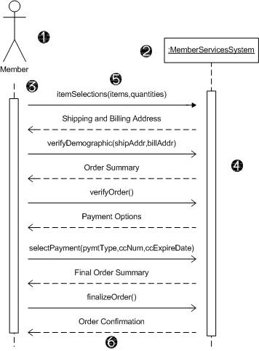
System Sequence Diagram Notations
Actor - the initiating actor of the use case is shown with the use case actor symbol.
System – the box indicates the system as a "black box" or as a whole. The colon (:) is standard sequence diagram notation to indicate a running "instance" of the system.
Lifelines – the dashed vertical lines extending downward from the actor and system symbols, which indicate the life of the sequence.
Activation bars – the bars set over the lifelines indicate period of time when participant is active in the interaction.
10-<number>
Notes:
Teaching Notes
The concepts are the same as with design-level sequence diagrams. But the system appears as a single entity.

Slide 3
System Sequence Diagram
Notations (cont.)
Input messages - horizontal arrows from actor to system indicate the message inputs. UML convention for messages is to begin the first word with a lowercase letter and add additional words with initial uppercase letter and no space. In parentheses include parameters, following same naming convention and separated with commas.
Output messages – horizontal arrows from system to actor shown as dashed lines. Since they are web forms, reports, e-mails, etc. these messages do not need to use the standard notation.
10-<number>
Notes:
No additional notes.

Slide 4
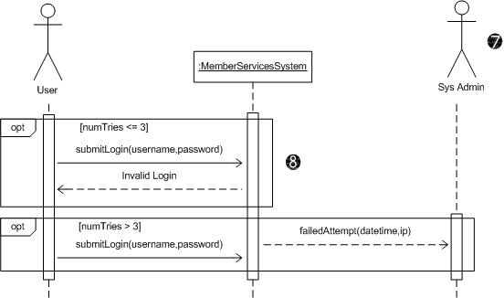
System Sequence Diagram
Notations (cont.)
Receiver Actor
– other actors or
external systems
that receive
messages from
the system can
be included.
Frame – a box
can enclose
one or more
messages to
divide off a fragment
of the sequence. These can show loops, alternate fragments, or optional (opt) steps. For an optional fragment the condition shown in square brackets indicates the conditions under which the steps will be performed.
10-<number>
Notes:
No additional notes.

Slide 5
Guidelines for Constructing System Sequence Diagrams
Identify which scenario of use case you will depict. Purpose is to discover messages, not to model logic. So more important to clearly communicate a single scenario.
Draw a rectangle representing the system as a whole and extend a lifeline under it.
Identify each actor who directly provides an input to the system or directly receives an output from the system. Extend lifelines under the actor(s).
Examine use case narrative to identify system inputs and outputs. Ignore messages inside system. Draw each external message as a horizontal arrow from the actor's lifeline to the system or from the system to the actor. Label inputs according to UML convention.
Add frames to indicate optional messages with conditions. Frames can also indicate loops and alternate fragments.
Confirm that the messages are shown in the proper sequence from top to bottom.
10-<number>
Notes:
Conversion Notes
This is a new slide for the seventh edition.

